Slide 1

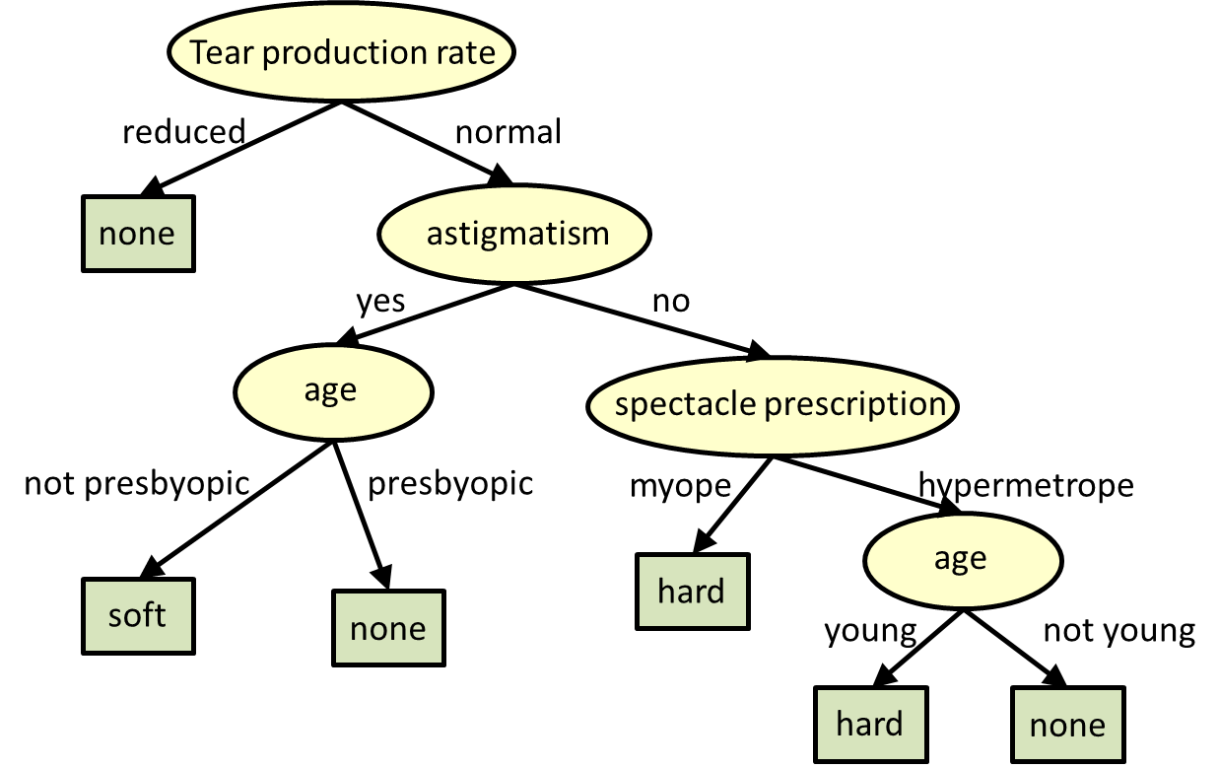

JA112
Decision Trees
and the ID3 Algorithm
John Abela
Department of CIS
Faculty of ICT
University of Malta
john.abela@um.edu.mt
+ 365 79367936
Room 1A/27
FICT Building
©John Abela, 2018-2022
Faculty of
ICT
Department of
Computer Information Systems
Last Updated
30-Oct-2022

Slide 2
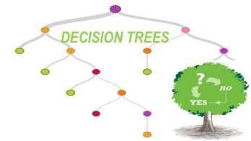
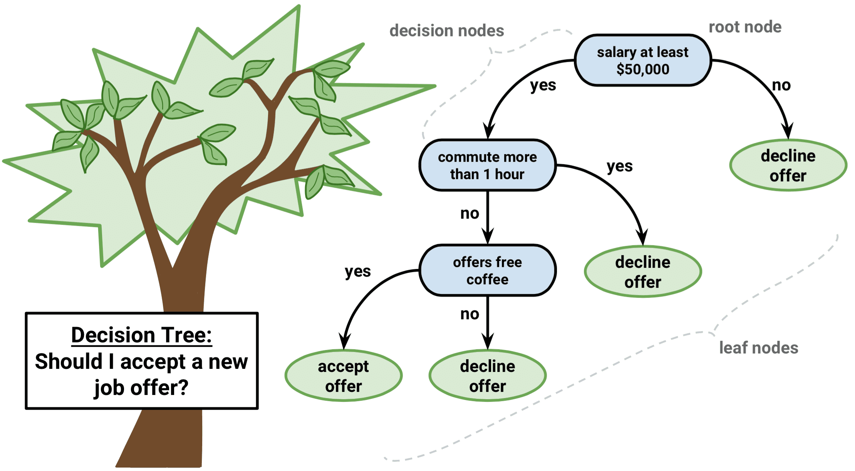

Decision Trees are Ubiquitous
ICT

Slide 3
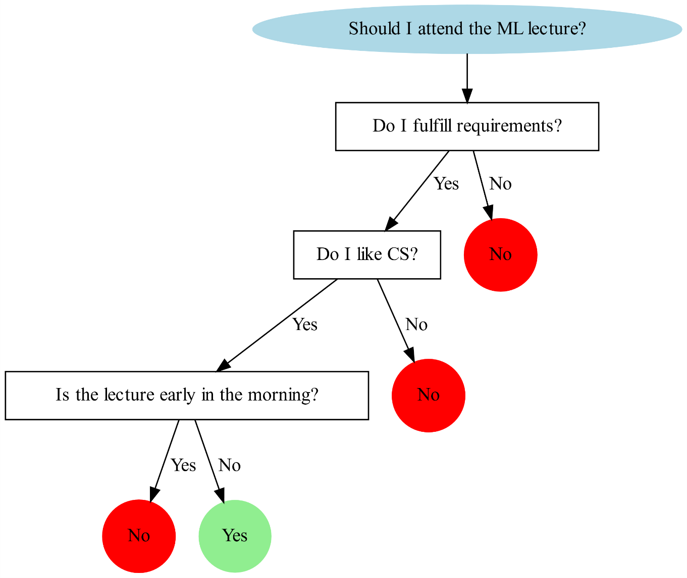
Decision Tree Learning
Practical inductive inference (supervised learning) method.
Find Boolean function of attributes.
Decision trees can be extended to functions with more than two output values.
Widely used & robust to noise.
Can handle disjunction (OR) of conjunctive (AND) expressions.
Completely expressive hypothesis space.
Easily interpretable (tree structure, if-then rules).
if
I (am bored and tired)
or
I am (hungry and angry)
then
I will stay inside
ICT

Slide 4
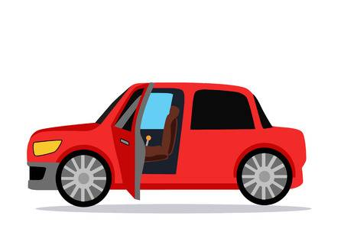
Object Attribute Value (OAV) Data
Objects have Attributes and Attributes have Values
For example, take the object Car.
Attributes include Colour, No of Doors, Style, Sunroof, etc.
Each attribute can have a finite number of possible values.
The set of attribute values pertaining to a particular car object is called a tuple.
Example Red, 2, Saloon, No
Colour | Doors | Style | Sunroof
Green | 2 | Coupe | No
Blue | 3 | Wagon | Yes
Red | 4 | Saloon
Yellow | 5 | Hatchback
Silver |  | Fastback
White |  | SUV
ICT

Slide 5
Concepts
A concept is a subset of all possible OAV tuples of an object.
The object car below has 6 x 4 x 6 x 2 = 288 possible tuples.
Consider now the concept Desirable Car.
This is a subset of all possible 288 tuples.
A class label is used to define the concept – which cars are desirable and which are not.
Colour | Doors | Style | Sunroof
Green | 2 | Coupe | No
Blue | 3 | Wagon | Yes
Red | 4 | Saloon
Yellow | 5 | Hatchback
Silver |  | Fastback
White |  | SUV
ICT

Slide 6
Concepts
Colour | Doors | Style | Sunroof | Label
Silver | 5 | Wagon | No | No
Green | 2 | Coupe | No | Yes
White | 4 | Saloon | Yes | No
Blue | 3 | Wagon | Yes | No
Red | 4 | Saloon | Yes | No
Blue | 2 | Coupe | No | Yes
Yellow | 5 | Hatchback | Yes | No
Silver | 2 | Fastback | No | No
Yellow | 5 | Wagon | Yes | No
White | 5 | SUV | No | No
Green | 2 | Coupe | No | Yes
Red | 2 | Coupe | Yes | Yes
White | 3 | Hatchback | Yes | No
Consider the subset of tuples shown in the table on right.
Remember that there are 288 possible tuples. We show a subset.
The tuples labelled Yes denote the members of the concept Desirable Car.
Note that all Desirable Cars are coupes.
The decision tree for Desirable Car is very simple!
Decision tree learning is an example of Concept Learning.
Style
Fastback
Hatchback
Wagon
SUV
Coupe
Saloon
ICT
No
No
No
Yes
No
No

Slide 7

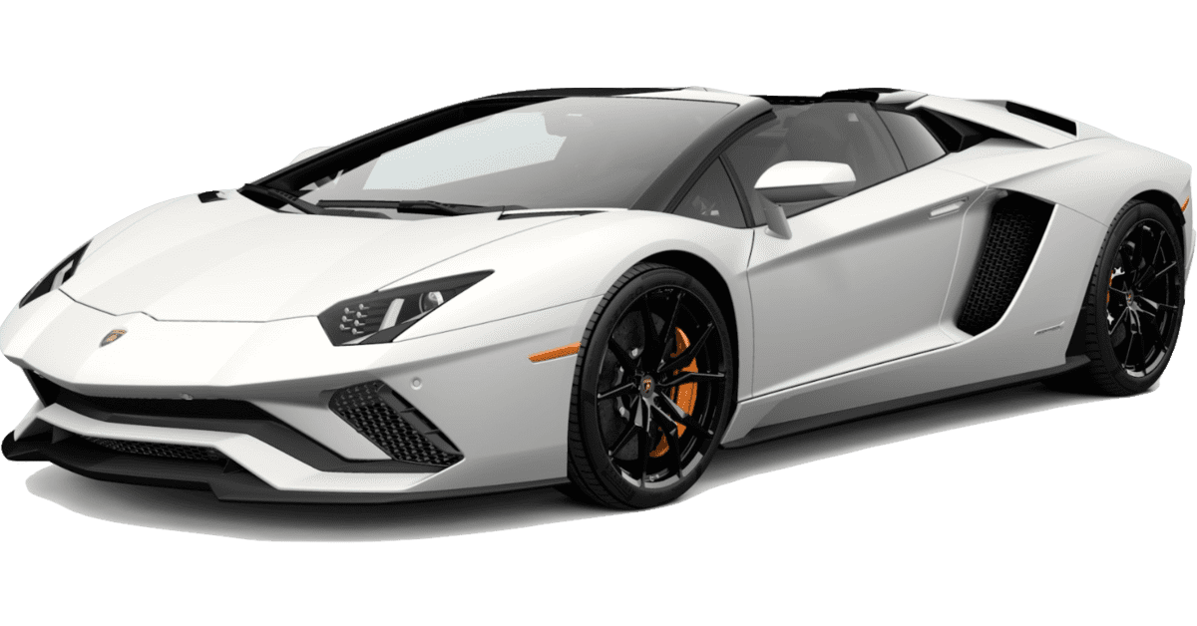
Desirable Car
ICT

Slide 8
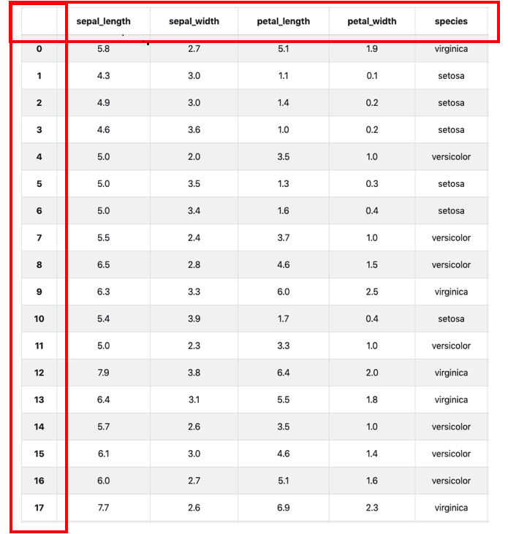



Object Attribute Value (OAV) Data
Label
OAV data usually comes as labelled CSV, XML, or JSON files.
One of the attributes, usually the first, is the Object ID.
Attributes can be numeric, categorical, or Boolean.
Many Kaggle datasets are OAV data in CSV or JSON format.
ID
ICT

Slide 9
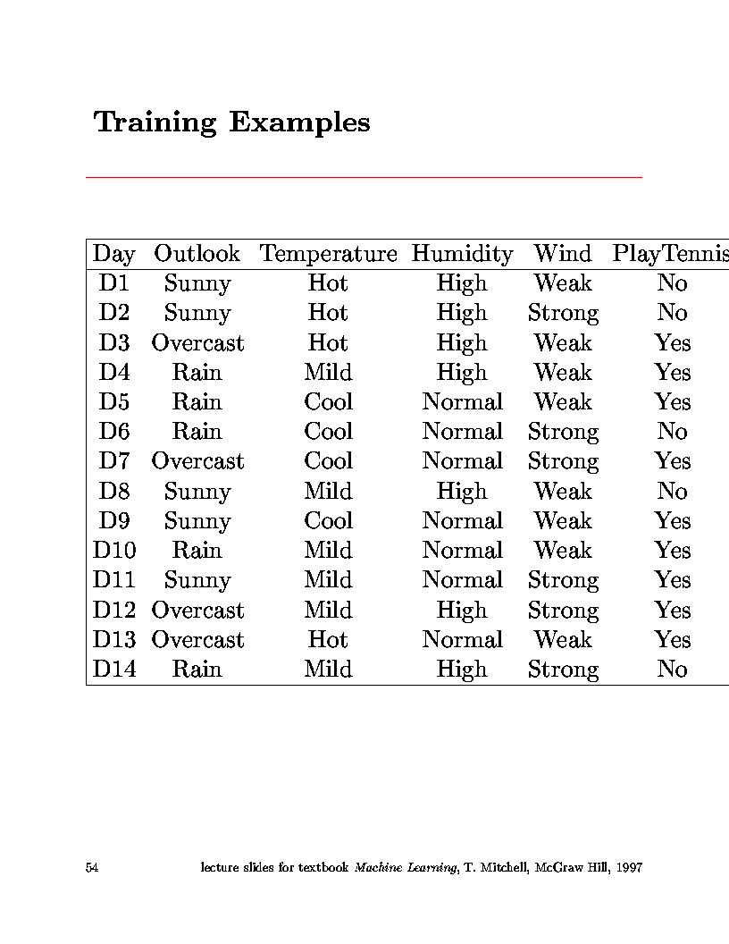
OAV Training Examples – Play Tennis
Attribute
Object ID
Value
Shall we play tennis today?
Class Label
ICT

Slide 10
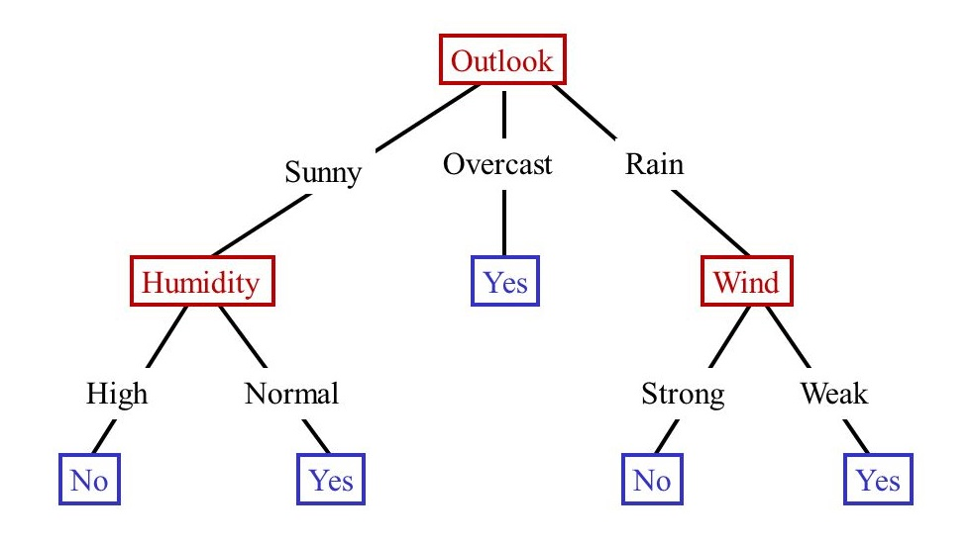
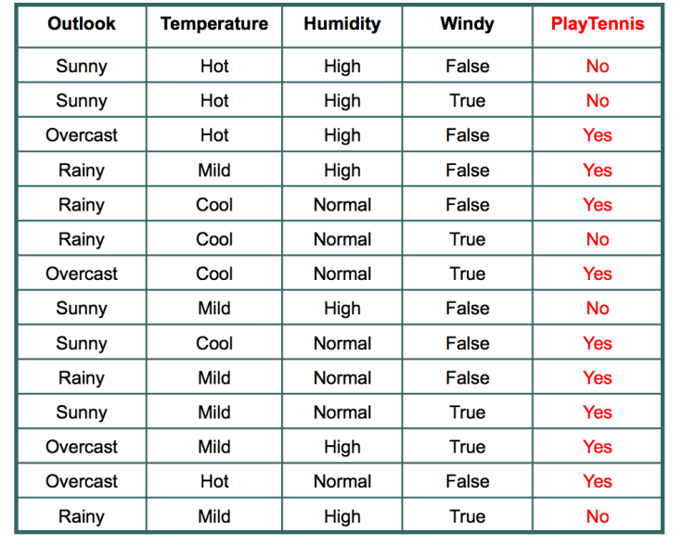
Decision Tree Example – Play Tennis
How many different decision trees are there that are consistent with the Play Tennis dataset?
Is the decision tree on the right the smallest possible decision tree?
Does a decision tree generalize?
How do you create different decision trees for a given dataset?
ICT

Slide 11
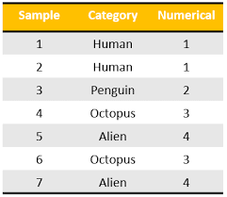
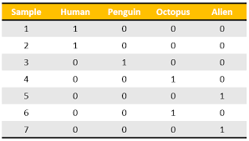
One Hot Encoding
One Hot Encoding is a scheme where categorical variables are encoded as Boolean ‘sparse’ vectors.
This ‘helps’ many machine learning algorithms because the encodings are now a high-dimension vector rather than a scalar or symbol.
ICT

Slide 12
Classification
Classification is the process of adding a new attribute, the class label to OAV data.
We start with a labelled OAV dataset. A labelled OAV dataset has a class label column.
Find a model for the class attribute as a function of the values of the other attributes .
Using the learned model, previously unseen records should be assigned a class as accurately as possible .
ICT

Slide 13
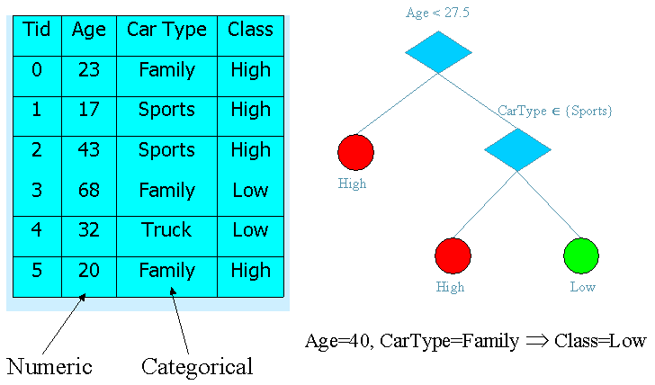
What is a Decision Tree?
A predictive model in the form of an upside-down tree.
Each node, except the leaves, represents an attribute of a given object.
Each edge represents a value of the parent attribute.
Each leaf is a class label.
Boolean attribute values are usually not shown. Left means Yes and right means No.
Insurance Risk
ICT

Slide 14
Decision Tree Example – Play Tennis
Decision trees are used to perform classification (or regression).
Classifies ALL OAV instances into one of a discrete set of possible categories.
The learned function is represented by a decision tree
Each node in the tree is a test on some attribute of an instance.
Branches represent values of attributes.
Follow the tree from root to leaves to find the output value.
ICT

Slide 15
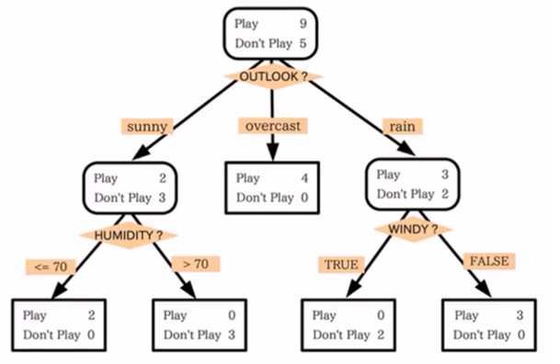
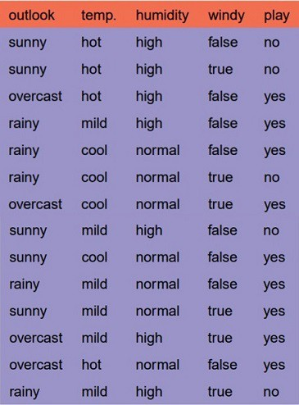
Decision Tree Interpretation
We play tennis when:
(Outlook=Sunny ∧ Humidity=Normal)
∨
(Outlook=Overcast)
∨
(Outlook=Rain ∧ Wind=Weak)
The tree itself forms a hypothesis.
Disjunction (OR’s) of conjunctions (AND’s)
Each path from the root to a leaf forms a conjunction of constraints on attributes - a rule.
Separate branches are disjunctions.
ICT

Slide 16
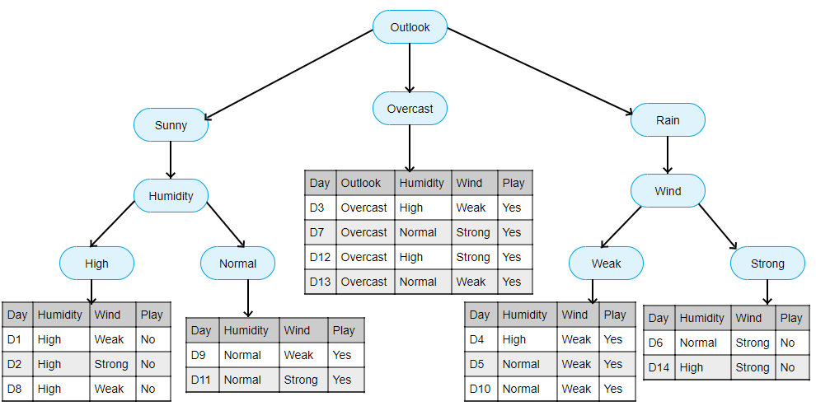
Naïve Decision Tree Construction
The basic idea is that, given a labelled dataset, we somehow must construct a decision tree that segments the dataset into subsets which are either all labelled Yes or No.
Each subset is associated with a rule – a path from the root to a leaf.
We must ideally create the shortest possible trees. Shorter trees are more general.
How is sunny, mild, high, true classified – note that this is not in the dataset?
ICT

Slide 17
Naïve Decision Tree Construction
Constructing a decision tree from a given labelled dataset is straightforward.
Constructing the shortest possible decision tree (least number of nodes or least height) is another matter.
For any given dataset there are a combinatorial number of decision trees that are consistent with the training set.
Humidity 9/5
normal
high
Temp 6/1
Outlook 3/4
cool
hot
mild
sunny
overcast
rainy
1/1
Outlook 3/1
Yes
Yes
No
Windy 1/1
Yes
1/0
2/0
0/3
2/0
sunny
rainy
overcast
false
true
Yes
Windy 1/1
Yes
Yes
No
1/0
1/0
1/0
0/1
false
true
Yes
No
1/0
0/1
ICT

Slide 18
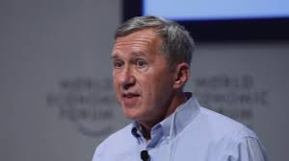
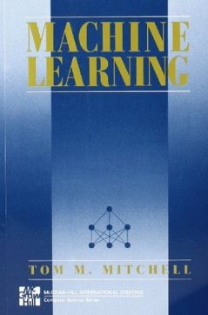
Decision Tree Uses
The Play Tennis dataset became popular, and famous, after publication of Tom Mitchell’s 1997 book.
Types of problems decision tree learning is good for include:
Instances represented by OAV object-attribute-value data:
In the algorithm in Tom Mitchell’s book, attributes take on a small number of discrete values.
Can be extended to real-valued attributes.
Target function has discrete output values.
Algorithm in book assumes Boolean functions. Output is Yes or No (True or False).
Can be extended to multiple output values.
Tom Mitchell
ICT

Slide 19
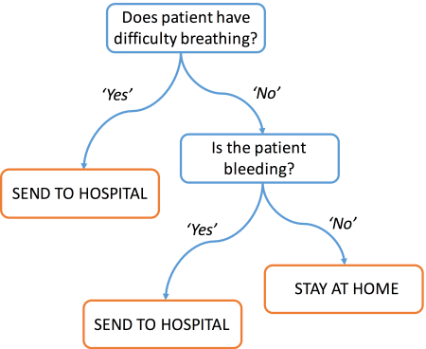
Decision Tree Uses
Hypothesis space can include disjunctive expressions.
In fact, hypothesis space is the complete space of finite discrete-valued functions
Robust to imperfect training data
classification errors
errors in attribute values
missing attribute values
Examples:
Equipment diagnosis
Medical diagnosis
Credit card risk analysis
Robot movement
Pattern Recognition
Face recognition
Object classification
ICT

Slide 20
Decision Tree Construction
Given a labelled OAV training set how does one create a decision tree for the class label?
If the training set is small this can probably done by (visual) inspection.
What if the training set is very large?
How many different decision trees are there that are consistent with the training data?
Are there algorithms that automatically find the shortest decision tree from labelled OAV data?
ICT

Slide 21
Decision Trees are usually not Unique
Given a labelled OAV training set there may be exponentially many decision trees that are consistent with (fit) the training examples.
Which decision tree is the best?
Refund
Yes
No
MarSt
Single, Divorced
Married
NO
MarSt
NO
Refund
Single, Divorced
Married
Yes
No
NO
TaxInc
TaxInc
NO
< 80K
> 80K
< 80K
> 80K
NO
YES
NO
YES
ICT

Slide 22
Which Decision Tree do we choose?
The set of all decision trees that are consistent with (fit) a labelled OAV training is called the Hypothesis Space.
Which hypothesis (decision tree) do we choose?
Given a training set, which of all of the decision trees consistent with that training set has the greatest likelihood of correctly classifying unseen instances of the population?
Occam’s Razor says we should choose the ‘simplest’.
In fact, it has been shown that the shortest decision tree is the best (most general).
ICT

Slide 23

How do we find the Shortest Decision Tree?
Forget trying to find the shortest consistent decision tree by inspection unless the number of training examples is very small.
We are going to use the ID3 Algorithm to do this.
ID3 is short for Inductive Dichotomizer 3.
Invented by Ross Quinlan.
He also invented C4.5
ID3 finds the shortest tree.
ICT
Ross Quinlan

Slide 24
ID3 Decision Tree Learning Algorithm
ID3 – Inductive Dichotomizer 3 Algorithm
Top-down, greedy search through space of possible decision trees
Remember, decision trees represent hypotheses, so this is a search through hypothesis space.
What is top-down?
How do we start the tree?
What attribute should represent the root?
As you proceed down tree, choose attribute for each successive node.
No backtracking.
Algorithm proceeds from top (the root) to bottom (the leaves).
ICT

Slide 25
ID3 Decision Tree Learning Algorithm
function ID3 (R: a set of non-categorical attributes,
C: the categorical attribute,
S: a training set) returns a decision tree;
begin
If S is empty, return a single node with value Failure;
If every example in S has the same value for categorical
attribute, return single node with that value;
If R is empty, then return a single node with most
frequent of the values of the categorical attribute found in
examples S; [note: there will be errors, i.e., improperly classified records];
Let D be attribute with largest Gain(D,S) among R’s attributes;
Let {dj| j=1,2, .., m} be the values of attribute D;
Let {Sj| j=1,2, .., m} be the subsets of S consisting
respectively of records with value dj for attribute D;
Return a tree with root labeled D and arcs labeled
d1, d2, .., dm going respectively to the trees
ID3(R-{D},C,S1), ID3(R-{D},C,S2) ,.., ID3(R-{D},C,Sm);
end ID3;
ICT

Slide 26

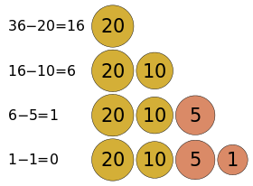
What is Greedy Search?
At each step, make decision which makes greatest improvement in whatever you are trying to optimize.
Do not backtrack (unless you hit a dead end).
This type of search is likely not to be a globally optimum solution, but generally works well.
What are we really doing here?
At each node of tree, make decision on which attribute best classifies training data at that point.
Never backtrack (in ID3).
Do this for each branch of tree.
End result will be tree structure representing a hypothesis which works best for the training data.
Example – giving (monetary) change.
ICT

Slide 27
ID3 Decision Tree Learning Algorithm
ID3 finds the smallest (shallowest) tree consistent with the training data.
ID3 uses two important concepts:
Entropy
Information Gain
Both are used in order to determine which attribute is the best class discriminator.
Choosing the best discriminator makes the tree shorter.
Shorter trees generalize better.
ICT

Slide 28
Choosing Attributes for the Decision Tree
Question?
How do you determine which attribute best classifies data?
Answer: Entropy!
Information Gain
Statistical quantity measuring how well an attribute classifies the data.
Calculate the information gain for each attribute.
Choose attribute with greatest information gain.
ICT

Slide 29
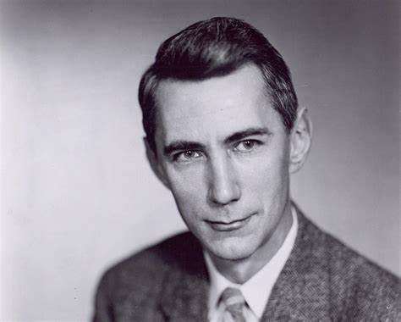
How do you Measure Information?
Claude Shannon in 1948 at Bell Labs established the field of information theory.
A mathematical function, Entropy, measures information content of a random process:
Takes on largest value when events are equi-probable.
Takes on smallest value when only one event has non-zero probability.
For two states:
Positive examples and Negative examples from set S:
H(S) = -p₊log₂(p₊) - p₋log₂(p₋)
ICT

Slide 30
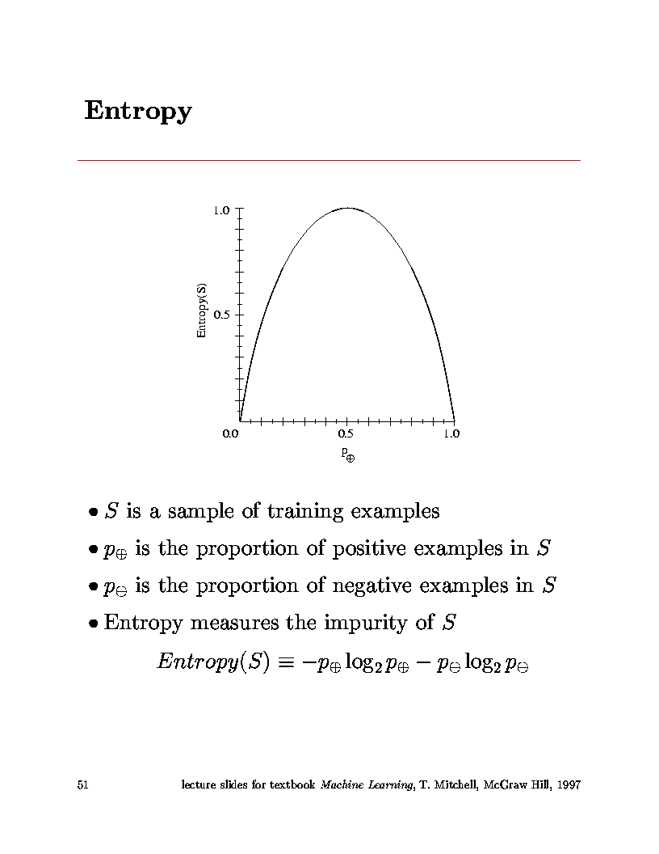
What is Entropy?
Highest entropy
Lowest entropy
ICT

Slide 31
Building a Decision Tree for PlayTennis
Four attributes used for classification:
Outlook = {Sunny, Overcast, Rain}
Temperature = {Hot, Mild, Cool}
Humidity = {High, Normal}
Wind = {Weak, Strong}
One predicted (class label) attribute (Boolean)
PlayTennis = {Yes,No}
Given 14 Training examples
9 positive
5 negative
ICT

Slide 32
Training Examples for PlayTennis
ICT

Slide 33
Information Gain
Information gain is our metric for how well one attribute A^{i} classifies the training data.
Information gain for a particular attribute =
Information about target function,
given the value of that attribute.
(conditional entropy)
Mathematical expression for information gain is:
ICT
Entropy of set S
Entropy for value v

Slide 34
ID3 for Boolean Valued Class Labels
Calculate the entropy for all training examples.
positive and negative cases
p₊ = #pos/Tot p₋ = #neg/Tot
H(S) = -p₊log₂(p₊) - p₋log₂(p₋)
Determine which single attribute best classifies the training examples using information gain.
For each attribute find:
Use attribute with greatest information gain as a root. Function P() is the proportion.
ICT

Slide 35
ID3 – Choosing the Root Node
H(S) = -p₊log₂(p₊) - p₋log₂(p₋)
14 training examples
9 positive, 5 negative
Calculate entropy for all cases
N_{Pos} = 9 N_{Neg} = 5 N_{Tot} = 14
H(S) = -(9/14)*log₂(9/14) - (5/14)*log₂(5/14) = 0.940
ICT

Slide 36
ID3 – Choosing the Root Node
Loop over all attributes and compute Entropy for each Attribute
Attribute = Outlook
Loop over values of Outlook
Outlook = Sunny
N_{Pos} = 2 N_{Neg} = 3 N_{Tot} = 5
H(Sunny) = -(2/5)*log₂(2/5) - (3/5)*log₂(3/5) = 0.971
Outlook = Overcast
N_{Pos} = 4 N_{Neg} = 0 N_{Tot} = 4
H(Overcast) = -(4/4)*log₂4/4) - (0/4)*log₂(0/4) = 0.00
Outlook = Rain
N_{Pos} = 3 N_{Neg} = 2 N_{Tot} = 5
H(Rain) = -(3/5)*log₂(3/5) - (2/5)*log₂(2/5) = 0.971
H(S) = -p₊log₂(p₊) - p₋log₂(p₋)
ICT

Slide 37
ID3 – Choosing the Root Node
Calculate Information Gain for attribute Outlook
Gain(S,Outlook) = H(S) - N_{Sunny}/N_{Tot}*H(Sunny) - N_{Over}/N_{Tot}*H(Overcast) - N_{Rain}/N_{Tot}*H(Rainy) Gain(S,Outlook) = 0.940 - (5/14)*0.971 - (4/14)*0 - (5/14)*0.971
Gain(S,Outlook) = 0.246
ICT
Entropy of set S
Entropy for value v

Slide 38
ID3 – Choosing the Root Node
Attribute = Temperature
(Repeat process looping over {Hot, Mild, Cool})
Gain(S,Temperature) = 0.029
Attribute = Humidity
(Repeat process looping over {High, Normal})
Gain(S,Humidity) = 0.029
Attribute = Wind
(Repeat process looping over {Weak, Strong})
Gain(S,Wind) = 0.048
Attribute with greatest information gain:
Gain(S,Outlook) = 0.246, Gain(S,Temperature) = 0.029
Gain(S,Humidity) = 0.029, Gain(S,Wind) = 0.048
∴ Outlook is the chosen root node of tree
ICT

Slide 39
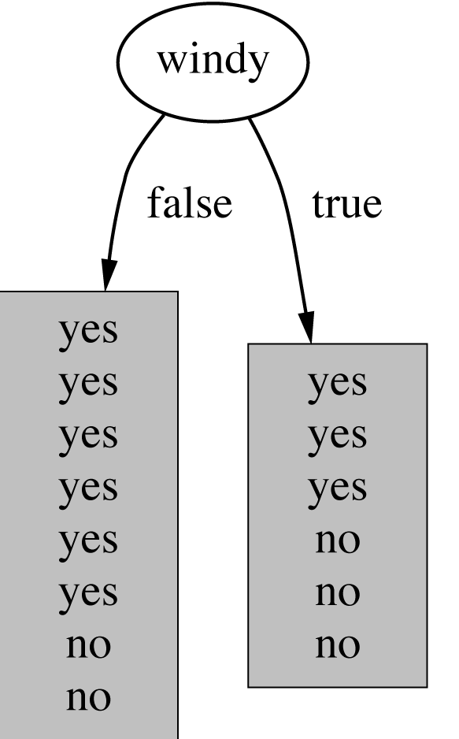
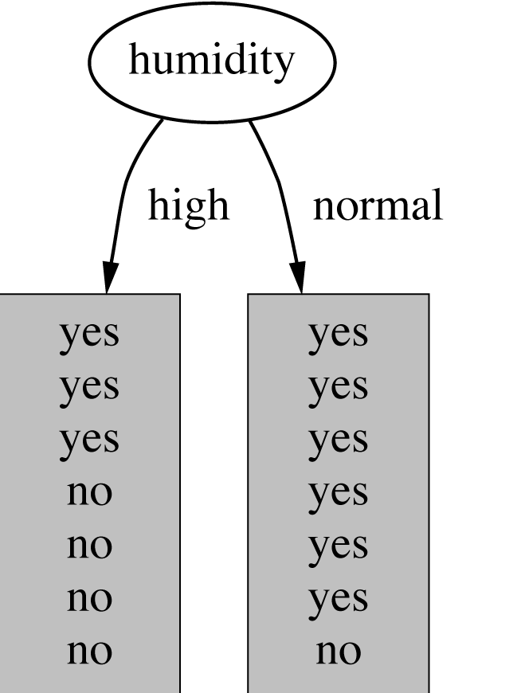
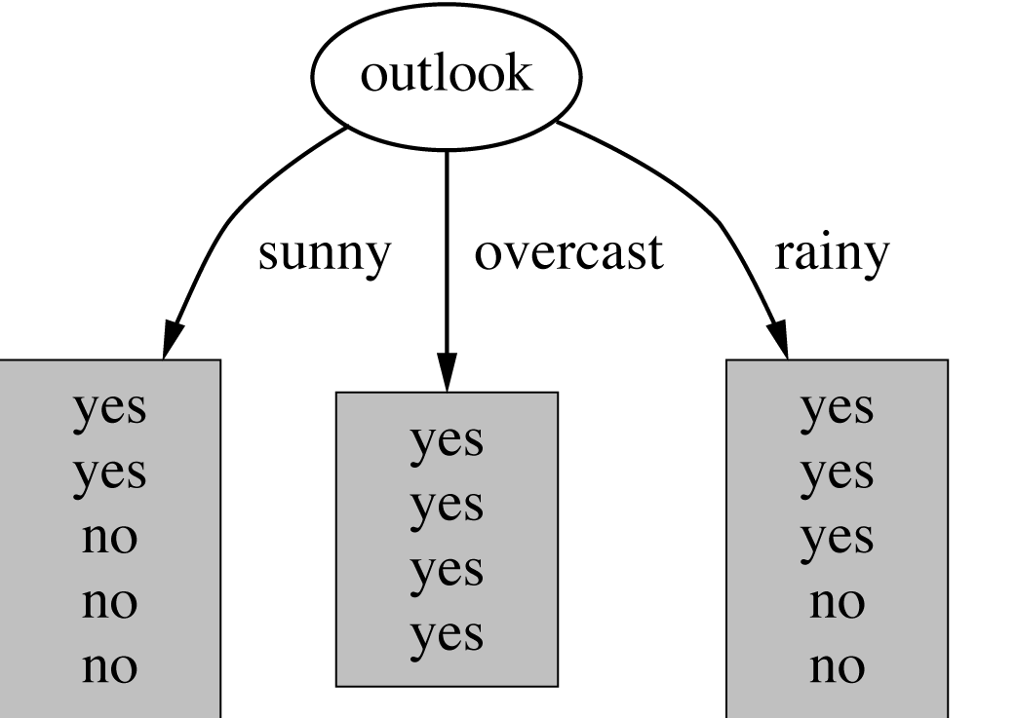
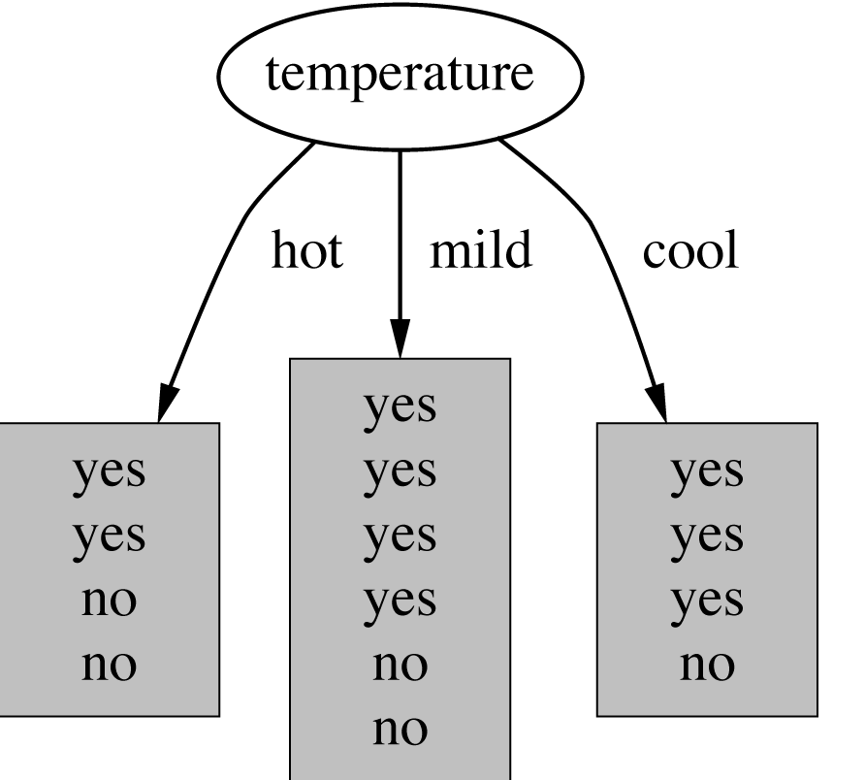
ID3 – Choosing the Root Node
ICT

Slide 40
ID3 – Choosing the Root Node
Iterate algorithm to find attributes which best classify training examples under the values of the root node
Example continued
Take three subsets:
Outlook = Sunny (N_{Tot} = 5)
Outlook = Overcast (N_{Tot} = 4)
Outlook = Rainy (N_{Tot} = 5)
For each subset, repeat the above calculation looping over all attributes other than Outlook
ICT

Slide 41
ID3 – Choosing the Root Node
For example:
Outlook = Sunny (N_{Pos} = 2, N_{Neg}=3, N_{Tot} = 5) H = 0.971
Temp = Hot (N_{Pos} = 0, N_{Neg}=2, N_{Tot} = 2) H = 0.0
Temp = Mild (N_{Pos} = 1, N_{Neg}=1, N_{Tot} = 2) H = 1.0
Temp = Cool (N_{Pos} = 1, N_{Neg}=0, N_{Tot} = 1) H = 0.0
Gain(S_{Sunny},Temperature) = 0.971 - (2/5)*0 - (2/5)*1 - (1/5)*0
Gain(S_{Sunny},Temperature) = 0.571
Similarly:
Gain(S_{Sunny},Humidity) = 0.971
Gain(S_{Sunny},Wind) = 0.020
Humidity classifies Outlook = Sunny instances best and is placed as the node under Sunny outcome.
Repeat this process for Outlook = Overcast & Rainy
ICT

Slide 42
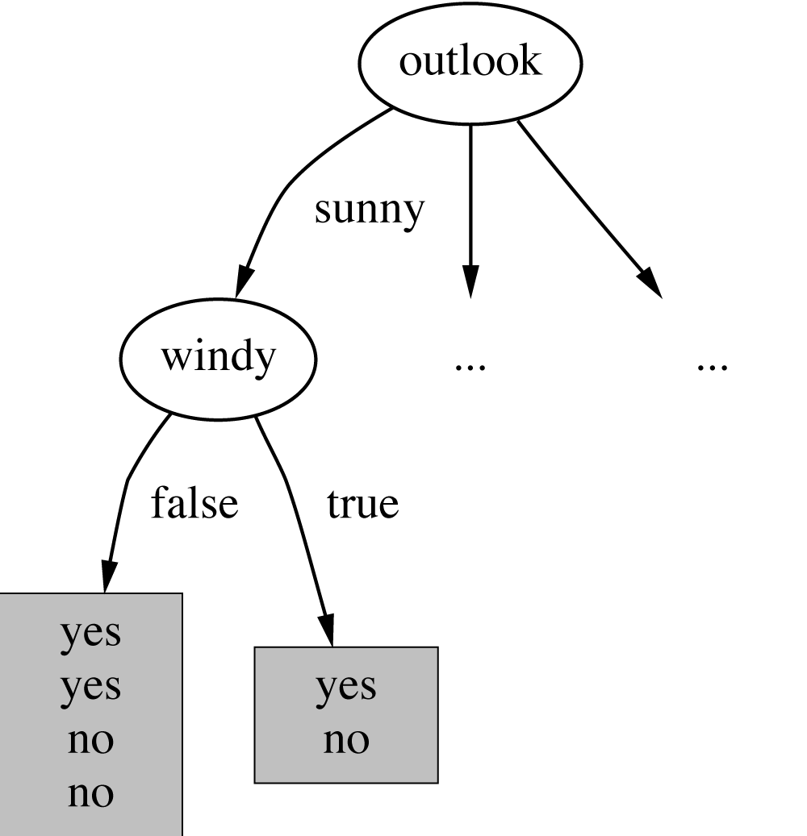
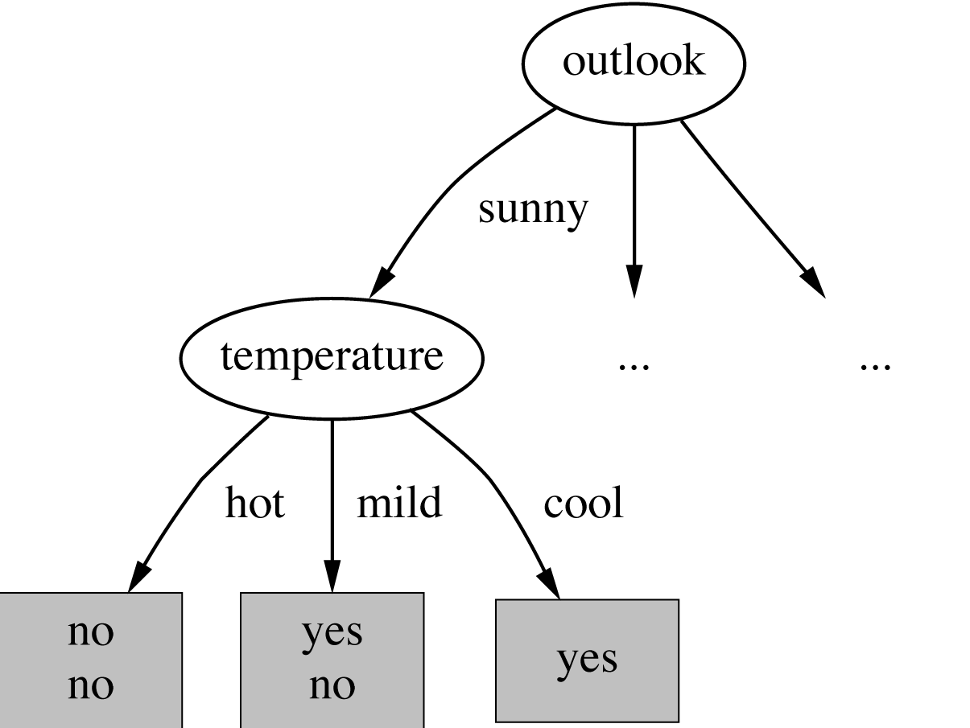
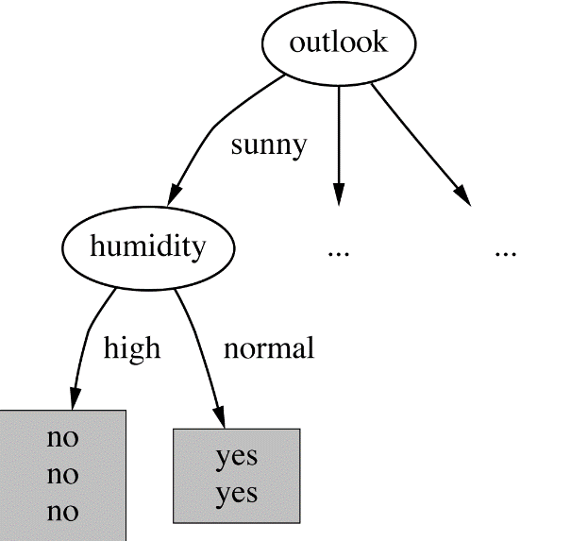
ID3 – Continuing to Split…
Gain(‘Temperature’) = 0.571
Gain(‘Wind’) = 0.020
Gain(‘Humidity’) = 0.971
ICT
witten&eie

Slide 43
ID3 – Restrictions
Attributes are excluded from consideration if they appear higher in the tree
Process continues for each new leaf node until:
Every attribute has already been included along path through the tree
or
Training examples associated with this leaf all have same target attribute value.

Slide 44
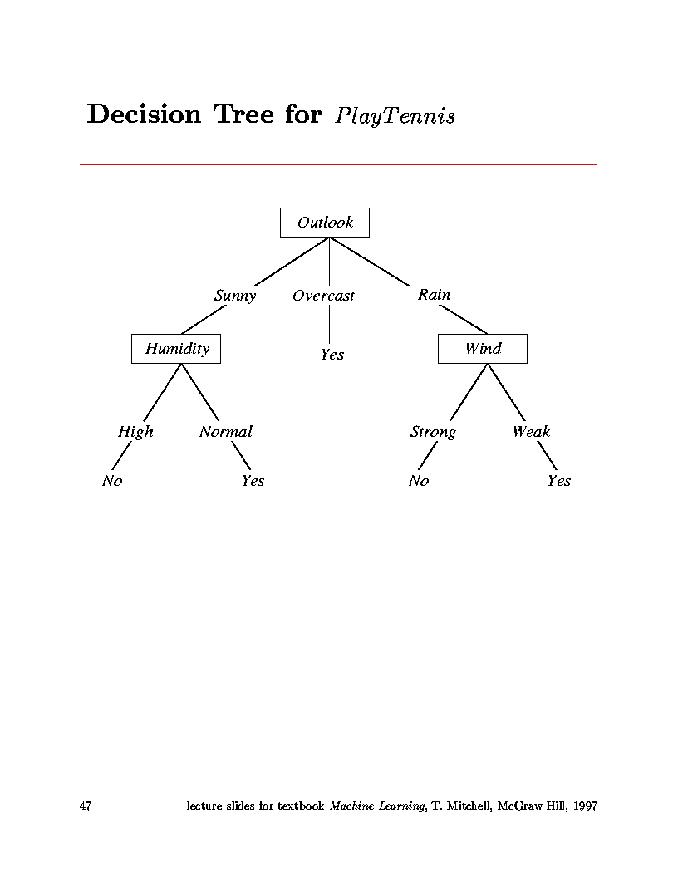
ID3 – Considerations
ICT

Slide 45
ID3 – Considerations
Note that in this example data were perfect.
No contradictions
Branches led to unambiguous Yes, No decisions
If there are contradictions take the majority vote
This handles noisy data.
Another note
Attributes are eliminated when they are assigned to a node and never reconsidered.
e.g. You would not go back and reconsider Outlook under Humidity
ICT

Slide 46
ID3 – Summary
A greedy algorithm for Decision Tree Construction developed by Ross Quinlan, 1987.
Consider a smaller tree a better tree.
Top-down construction of the decision tree by recursively selecting the "best attribute" to use at the current node in the tree, based on the examples belonging to this node.
Once the attribute is selected for the current node, generate children nodes, one for each possible value of the selected attribute.
Partition the examples of this node using the possible values of this attribute, and assign these subsets of the examples to the appropriate child node.
Repeat for each child node until all examples associated with a node (leaf) are either all positive or all negative.
ICT

Slide 47
Decision Trees – Choosing the Best Attribute
The key problem is choosing which attribute to split a given set of examples.
Some possibilities are:
Random: Select any attribute at random
Least-Values: Choose the attribute with the smallest number of possible values (fewer branches)
Most-Values: Choose the attribute with the largest number of possible values (smaller subsets)
Max-Gain: Choose the attribute that has the largest expected information gain, i.e. select attribute that will result in the smallest expected size of the subtrees rooted at its children.
The ID3 algorithm uses the Max-Gain method of selecting the best attribute.
ICT

Slide 48
Inductive Bias of ID3
Inductive Bias: (restriction vs. preference)
ID3
searches complete hypothesis space
But, incomplete search through this space looking for simplest tree
This is called a preference (or search) bias
Candidate-Elimination
Searches an incomplete hypothesis space
But, does a complete search finding all valid hypotheses
This is called a restriction (or language) bias
Typically, preference bias is better since you do not limit your search up-front by restricting hypothesis space considered.
ICT

Slide 49
How well do Decision Trees work?
Many case studies have shown that decision trees are at least as accurate as human experts.
A study for diagnosing breast cancer:
humans correctly classifying the examples 65% of the time,
the decision tree classified 72% correct.
British Petroleum designed a decision tree for gas-oil separation for offshore oil platforms/
It replaced an earlier rule-based expert system.
Cessna designed an airplane flight controller using 90,000 examples and 20 attributes per example.
ICT

Slide 50
Some Decision Tree Algorithms
Algorithms used:
ID3 Quinlan (1986)
C4.5 Quinlan(1993)
C5.0 Quinlan
Cubist Quinlan
CaRT Classification and Regression Trees - Breiman (1984)
ASSISTANT Kononenco (1984) & Cestnik (1987)
ID3 is algorithm discussed in the Tom Mitchell textbook.
Simple, but representative.
Source code widely and publicly available.
Entropy used for the first time.
C4.5 (and C5.0) are extensions of ID3 that account for unavailable values, continuous attribute value ranges, pruning of decision trees, rule derivation, and so on.
Faculty of
ICT
Next

Slide 51
Noisy Data and Overfitting
Many kinds of "noise" that could occur in the examples:
Two examples have same attribute/value pairs, but different classifications
Some values of attributes are incorrect because of:
Errors in the data acquisition process
Errors in the preprocessing phase
The classification is wrong (e.g., + instead of -) because of some error
Some attributes are irrelevant to the decision-making process,
e.g., color of a die is irrelevant to its outcome.
Irrelevant attributes can result in overfitting the training data.
ICT

Slide 52
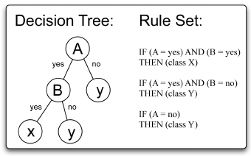
Decision Tree to Rules
It is easy to derive a rule set from a decision tree: write a rule for each path in the decision tree from the root to a leaf.
In that rule the left-hand side is easily built from the label of the nodes and the labels of the arcs.
The resulting rules set can be simplified:
Let LHS be the left hand side of a rule.
Let LHS' be obtained from LHS by eliminating some conditions.
We can certainly replace LHS by LHS' in this rule if the subsets of the training set that satisfy respectively LHS and LHS' are equal.
A rule may be eliminated by using metaconditions such as "if no other rule applies".
ICT

Slide 53

C4.5 Decision Tree Algorithm
C4.5 is an extension of ID3 that accounts for unavailable values, continuous attribute value ranges, pruning of decision trees, rule derivation, and so on.
C4.5: Programs for Machine Learning
J. Ross Quinlan, The Morgan Kaufmann Series in Machine Learning, Pat Langley,
Series Editor. 1993. 302 pages. paperback book & 3.5" Sun disk. $77.95. ISBN 1-55860-240-2
ICT

Slide 54
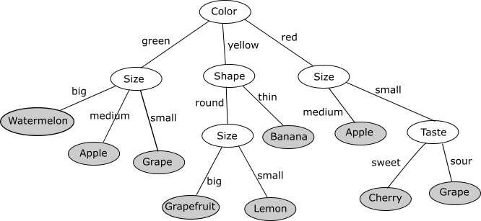
Decision Trees have any Uses
ICT

Slide 55
Summary Decision Tree Learning
Inducing decision trees is one of the most widely used learning methods in practice
Can out-perform human experts in many problems
Strengths include
Fast
simple to implement
can convert result to a set of easily interpretable rules
empirically valid in many commercial products
handles noisy data
Weaknesses include:
"Univariate" splits/partitioning using only one attribute at a time so limits types of possible trees
large decision trees may be hard to understand
requires fixed-length feature vectors
ICT

Slide 56
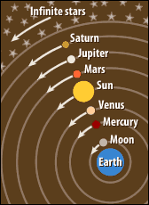
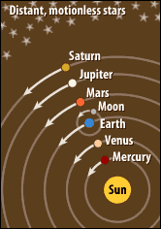
Summary of ID3 Inductive Bias
Short trees are preferred over long trees
It accepts the first tree it finds
Information gain heuristic
Places high information gain attributes near root
Greedy search method is an approximation to finding the shortest tree
Why would short trees be preferred?
Example of Occam’s Razor:
Prefer simplest hypothesis consistent with the data.
(Like Copernican vs. Ptolemaic view of Earth’s motion)
ICT

